Slide 1
Source Code Management
Advanced Git Concepts
Notes:
Notes to the Facilitator:
Introduce the module to the participants.
Notes to the Participants:
In this module, you will delve into the realm of remote repositories, a fundamental aspect of Git that extends collaboration beyond individual workstations. You'll explore the intricacies of fetching, pulling, and pushing changes, unraveling the mechanisms that enable seamless collaboration among team members. Additionally, the module will guide you through the nuances of working with remote branches, providing insights into managing collaborative development efforts. As you progress, you'll discover the power of Git Hooks, mechanisms that allow for the customization and automation of various stages in the Git workflow, enhancing your ability to tailor version control processes to specific project requirements. This module offers a comprehensive exploration of these advanced Git concepts, empowering you to optimize collaboration and streamline development workflows in a distributed and interconnected development environment.
We will learn how!

Slide 2

Module Learning Objectives
At the end of this module, you will be able to learn :
  Learn to work with remote repositories, including cloning and setting up tracking branches.
  Understand how to synchronize changes between local and remote repositories.
  Explore advanced techniques for working with branches in remote repositories.
  Implement pre-commit and post-commit hooks, customizing Git behavior.
Notes:
Notes to the Facilitator:
Explain the module objectives to the participants.
Notes to the Participants:
You will be informed about the module objectives.
At the end of this module, you will be able to learn:
Learn to work with remote repositories, including cloning and setting up tracking branches.
Understand how to synchronize changes between local and remote repositories.
Explore advanced techniques for working with branches in remote repositories.
Implement pre-commit and post-commit hooks, customizing Git behavior.

Slide 3
3.1 Advanced Git Concepts
Let us take a quick look at the topics that we will cover in this module:
  Remote repositories
  Fetching, pulling, pushing changes
  Working with remote branches
  Git Hooks
Notes:
Notes to the Facilitator:
Inform the participants about the topics that they will be learning in this module.
Notes to the Participants:
In this module, we will delve into the following key topics:
Remote repositories
Fetching, pulling, pushing changes
Working with remote branches
Git Hooks

Slide 4
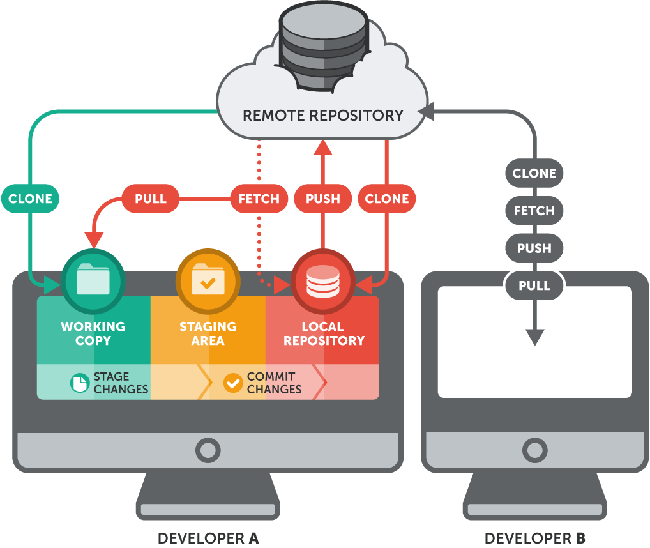
4.1.1 Defining Remote Repositories
Remote repositories are mirrored copies of a project's repository hosted on a server.
Key Characteristics
Central Hub
Collaboration Hub
Notes:
Notes to the Facilitator:
Guide participants through the foundational understanding of remote repositories as centralized and collaborative hubs in Git, emphasizing their role in streamlining version control and promoting efficient teamwork in a distributed development environment.
Notes to the Participants:
Remote repositories serve as the backbone of collaborative development in Git, providing a centralized and shared hub for project code. When we talk about remote repositories, we refer to mirrored copies of a project's repository hosted on a server, enabling multiple developers to work on the same project concurrently. These repositories act as central hubs where project code is stored, accessed, and collaborated upon. The fundamental functionality of remote repositories lies in facilitating efficient code sharing and version control. Developers can share and synchronize changes seamlessly, ensuring that the entire team has access to a unified and up-to-date codebase. In essence, understanding remote repositories is pivotal for fostering a collaborative and organized approach to development, where a centralized code management system ensures efficient collaboration among team members.
Key Characteristics:
Remote repositories are fundamental components in collaborative Git workflows, offering distinct characteristics that shape their pivotal role in modern software development. The key characteristics of remote repositories are central to establishing a cohesive and shared development environment and fostering effective collaboration among team members.
Central Hub:
One key characteristic of remote repositories is their role as a central hub for project code. In a distributed development environment, each team member may have their own local copy of the repository, but the remote repository serves as the central storage location. It functions as the authoritative source, housing the master version of the codebase. This centralization ensures a unified and consistent project history, streamlining collaboration and providing a reference point for all contributors.
Collaboration Hub:
Another vital characteristic is that remote repositories act as collaboration hubs. They create a shared space where developers can contribute, access, and synchronize their work. This collaborative aspect is particularly crucial in team-based projects, allowing developers to work on different aspects simultaneously. Through the remote repository, team members can share their changes, resolve conflicts, and maintain a cohesive and updated project state. This collaborative hub serves as the nexus for efficient teamwork, ensuring that everyone is on the same page throughout the development process.

Slide 5


4.1.1 Defining Remote Repositories
Here are the functions and significance of remote repositories:
Functionality
Code Sharing
Version Control
Centralized Collaboration
Efficient Code Management
Significance
Notes:
Notes to the Facilitator:
Guide the participants through recognizing the pivotal functionality of remote repositories, emphasizing seamless code sharing, robust version control mechanisms, and their significant role in centralizing collaboration for efficient code management in collaborative software development.
Notes to the Participants:
Functionality:
In the context of remote repositories, functionality refers to the key operations that enable seamless collaboration and version control. It encompasses a range of actions, including code sharing, synchronization, and maintaining a cohesive project history.
Code Sharing:
One primary function of remote repositories is to facilitate code sharing among team members. Developers can share their changes with the entire team by pushing their commits to the remote repository. This collaborative aspect allows for concurrent work on the same project, fostering a dynamic and productive development environment.
Version Control:
Version control is at the core of remote repository functionality. Through version control mechanisms, remote repositories enable developers to keep track of changes, revert to previous states, and manage the evolution of the codebase over time. Version control ensures that the project's history is well-documented and that contributors can collaborate without the risk of conflicting changes.
Significance:
Understanding the significance of remote repositories sheds light on their crucial role in optimizing collaboration and ensuring efficient code management in software development.
Centralized Collaboration:
One significant aspect of remote repositories is their ability to centralize collaboration. By serving as a centralized hub for project code, they create a unified space where team members can collaborate seamlessly. This centralization fosters a collaborative environment where developers can share changes, track progress, and coordinate their efforts effectively. Centralized collaboration ensures that the entire team works cohesively towards common project goals.
Efficient Code Management:
Another vital significance lies in the efficient management of code. Remote repositories streamline the process of code sharing, synchronization, and version control. With a centralized repository, developers can efficiently manage code changes, ensuring that everyone has access to the latest versions. This centralized approach simplifies the coordination of development tasks, reduces the risk of errors, and enhances overall project efficiency. Efficient code management is essential for maintaining code integrity and promoting a structured and organized development workflow.

Slide 6



4.1.2 Cloning a Remote Repository
It involves obtaining a local copy of the project, enabling active contribution and synchronization with the remote codebase.
Git Clone Command:
git clone
Remote Repository
It efficiently fetches the entire repository, including branches and commit history, ensuring a comprehensive local copy.
git clone
Local Repository
Notes:
Notes to the Facilitator:
Guide participants through the critical significance of cloning a remote repository, emphasizing its role as the gateway to collaborative development and the foundation for individual contribution within Git workflows.
Notes to the Participants:
Cloning a remote repository serves as the foundational step in collaborative Git workflows, laying the groundwork for effective teamwork and shared development. This process entails creating a local duplicate of the project's repository, a crucial maneuver that allows developers to interact with and contribute to the codebase. By initiating this cloning procedure, individuals gain autonomy to work on the project independently while fostering synchronization with the central remote repository. This ensures that developers have a comprehensive local copy, enabling them to make changes, experiment, and contribute effectively to the collective project, marking the initiation of a collaborative and cohesive development journey.
Git Clone Command:
The primary tool for cloning remote repositories is the git clone command.
Executing this command efficiently fetches the entire repository, including all branches, commit history, and associated files.
The git clone command establishes a link between the local machine and the remote repository, creating a synchronized and connected development environment.
Key Considerations:
Cloning is essential for collaborative workflows, providing each developer with their working copy of the project.
The git clone command simplifies the process, making it accessible to both beginners and experienced developers.
This command ensures that developers have a complete and up-to-date version of the project on their local machines, setting the stage for seamless collaboration and contribution.

Slide 7
4.1.2 Practical Steps
Here is how to bring a shared project onto your computer in a few simple steps:
Executing the git clone Command:git clone
https://github.com/example/repository.git
1
Seamless Retrieval:
Fetches entire codebase, branches, and history, creating a new directory, ensuring seamless retrieval.
2
Verification:
Confirm retrieval by navigating to the cloned directory (cd repository).
3
Collaboration Readiness
Prepared for changes and contributions with your local copy.
4
Notes:
Notes to the Facilitator:
Guide participants through the straightforward process of cloning a remote repository, emphasizing the analogy of making a shared project copy and its significance in collaborative development.
Notes to the Participants:
Let's learn how to bring a shared project onto your computer in a few simple steps. Cloning a remote repository with Git is like making a copy of a group project so that everyone can work on it independently and share their changes easily
Executing the git clone Command:
Open your terminal or command prompt.
Navigate to the directory where you want to clone the repository.
Use the command git clone followed by the remote repository URL.
Example: git clone https://github.com/example/repository.git
Replace the URL with the actual URL of the remote repository.
Seamless Retrieval:
This command fetches the entire codebase, including branches and commit history, and creates a new directory with the project's name.
The cloning process establishes a direct link between your local machine and the remote repository, ensuring seamless retrieval of the codebase.
Verification:
After cloning, navigate into the newly created directory (cd repository) to verify that the codebase has been successfully retrieved.
Collaboration Readiness:
You are now ready to collaborate, make changes, and contribute to the project using your local copy.
Note:
Ensure you have the necessary permissions to access the remote repository, and replace the example URL with the actual URL of the repository you intend to clone.

Slide 8
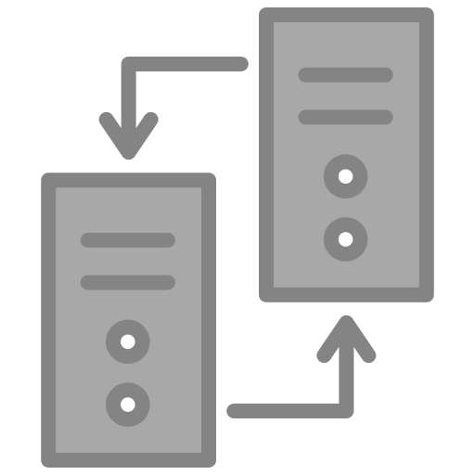




4.1.2 Benefits of Cloning
Some benefits of cloning are as follows:
Complete Local Copy
Offline Work Capability
Efficient Collaboration
Synchronization with Updates
Notes:
Notes to the Facilitator:
Explore the advantages of cloning a remote repository in Git, gaining a complete local copy for flexible offline work, establishing direct links for seamless synchronization, and fostering efficient collaboration with the team.
Notes to the Participants:
Discover the advantages that come with the powerful process of cloning a remote repository in Git, offering you a complete local copy and unlocking a range of benefits for seamless collaboration and individual contribution.
Benefits of Cloning:
Complete Local Copy: Cloning provides you with a comprehensive local copy of the entire project, including all files, branches, and commit history.
Offline Work Capability: Having a local copy allows you to work on the project even when you're offline, making development more flexible.
Direct Link with Remote: Cloning establishes a direct link between your local machine and the remote repository, ensuring seamless communication and synchronization.
Efficient Collaboration: With your own local copy, you can make changes, experiment, and contribute to the project without affecting the central repository until you're ready to share your updates.
Synchronization with Updates:You can easily synchronize your local copy with the latest changes from the remote repository, keeping your work up-to-date with the collaborative efforts of the team.
In essence, cloning provides the autonomy and flexibility needed for efficient collaboration in a shared development environment.

Slide 9
4.1.3 Tracking Branches
Here's a brief guide on Git tracking branches for collaboration.
  Local branch linked to a specific remote branch.
  Facilitates automatic synchronization for updates.
Git Command:
git branch --set-upstream-to=origin/remote-branch local-branch
Here, origin/remote-branch represents the remote branch you want to track, and local-branch is the name of your local branch
Notes:
Notes to the Facilitator:
Guide the participants in understanding the concept of tracking branches in Git, emphasizing its significance in automatic synchronization between local and remote branches. The provided Git command demonstrates the essential process of setting up tracking branches, ensuring an efficient and collaborative development environment.
Notes to the Participants:
In Git, a tracking branch is a local branch that is linked to a specific remote branch. This linkage facilitates automatic synchronization between the local and remote branches, allowing developers to stay updated on changes made by others in the shared repository.
Setting up tracking branches is a pivotal practice in Git that ensures a smooth flow of information between your local development environment and the shared remote repository. This process is essential for maintaining synchronization, enabling your local branches to automatically stay updated with any changes made by collaborators in the remote branches. By establishing this tracking relationship, developers can seamlessly collaborate while minimizing manual interventions to keep their codebase aligned with the broader project's progress.
Git Command:
The command for setting up tracking branches is executed using the following syntax:
git branch --set-upstream-to=origin/remote-branch local-branch
Here, origin/remote-branch represents the remote branch you want to track, and local-branch is the name of your local branch. This command explicitly establishes the tracking relationship between the specified local and remote branches. It serves as a pivotal link, allowing Git to automatically synchronize changes, making the collaborative development process more efficient, and ensuring that your local work remains in harmony with the broader project's development path.

Slide 10
4.1.3 Practical Steps Contd..
Here are the practical steps of setting up tracking branches in Git:
Open Terminal or Command Prompt:
Launch your terminal or command prompt on your local machine.
1
Navigate to Your Project Directory:
Use the cd command to navigate to the directory where your Git project is located.
2
Notes:
Notes to the Facilitator:
Steer participants through the hands-on experience of setting up tracking branches, emphasizing its significance in fostering seamless collaboration and bidirectional synchronization.
Notes to the Participants:
Embark on a hands-on journey as we explore the practical steps of setting up tracking branches in Git. This essential process ensures that your local development harmonizes effortlessly with the collaborative efforts of your team, paving the way for efficient synchronization and impactful collaboration.
Practical Steps:
Open Terminal or Command Prompt:
Launch your terminal or command prompt on your local machine.
Navigate to Your Project Directory:
Use the cd command to navigate to the directory where your Git project is located.

Slide 11
4.1.3 Practical Steps Contd..
Here are the practical steps of setting up tracking branches in Git:
Execute Tracking Branch Command:
  Enter the command: git branch --set-upstream-to=origin/remote-branch local-branch.
  Replace "origin/remote-branch" with the name of the remote branch you want to track and "local-branch" with your local branch name.
3
3
Notes:
Notes to the Facilitator:
Guide participants through hands-on steps for setting up tracking branches in Git.
Notes to the Participants:
Execute Tracking Branch Command:
Enter the command git branch --set-upstream-to=origin/remote-branch local-branch.
Replace "origin/remote-branch" with the name of the remote branch you want to track and "local-branch" with your local branch name.

Slide 12
4.1.3 Practical Steps Contd..
Here are the practical steps of setting up tracking branches in Git:
Verify Tracking Setup:
Confirm the setup by using git branch -vv to view the tracking information for your local branches.
4
Explore Synchronization:
  Make changes in your local branch and use git push to push changes to the remote branch.
  Pull changes from the remote using git pull to ensure bidirectional synchronization.
5
Notes:
Notes to the Facilitator:
Guide participants through hands-on steps for setting up tracking branches in Git.
Notes to the Participants:
Verify Tracking Setup:
Confirm the setup by using git branch -vv to view the tracking information for your local branches.
Explore Synchronization:
Make changes in your local branch and use git push to push changes to the remote branch.
Pull changes from the remote using git pull to ensure bidirectional synchronization.

Slide 13
4.1.3 Practical Steps
Here are the practical steps of setting up tracking branches in Git:
Collaborate Seamlessly:
Now, your local and remote branches are connected, allowing you to collaborate seamlessly with others in the project.
6
3
Notes:
Notes to the Facilitator:
Guide participants through hands-on steps for setting up tracking branches in Git.
Notes to the Participants:
Collaborate Seamlessly:
Now, your local and remote branches are connected, allowing you to collaborate seamlessly with others in the project.
By following these practical steps, you establish tracking branches, enabling efficient collaboration and automatic synchronization with the broader project.

Slide 14
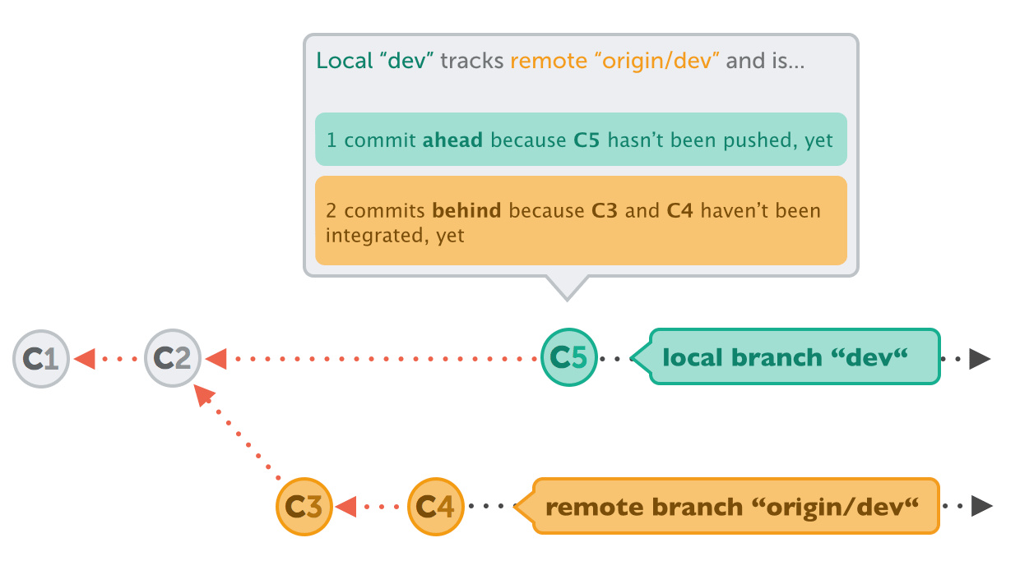
4.1.3 Benefits of Tracking Branches
Here are the benefits of Tracking Branches:
Benefits
Automated Synchronization
Efficient Collaboration
Clear Code Visibility
Minimized Errors
Streamlined Contribution Workflow
Notes:
Notes to the Facilitator:
Guide participants through the numerous advantages of tracking branches in Git, highlighting automated synchronization, efficient collaboration, enhanced code visibility, minimized errors, and a streamlined contribution workflow. Understanding these benefits will empower participants to optimize their Git workflows for a more organized and collaborative development environment.
Notes to the Participants:
Uncover the multitude of advantages that tracking branches bring to your Git workflow, including streamlining collaboration, automating synchronization, and providing a clear path for seamless integration of changes within your development environment.
Benefits of Tracking Branches:
Automated Synchronization: Tracking branches automates the synchronization process, ensuring that changes made locally and remotely stay harmonized without manual intervention.
Efficient Collaboration: Facilitates efficient collaboration by allowing developers to work on their local branches while seamlessly integrating updates from others in the project.
Clear Code Visibility: Enhances code visibility by establishing a direct link between local and remote branches, providing a transparent view of the project's development path.
Minimized Errors: Minimizes errors by reducing the chances of divergence between local and remote branches, promoting consistency across the entire development team.
Streamlined Contribution Workflow: Creates a streamlined contribution workflow, enabling developers to focus on their tasks without worrying about manual synchronization or conflicts.
The benefits of tracking branches in Git contribute to a more organized, collaborative, and error-resistant development environment.

Slide 15
What did you grasp?
What does the git clone command do in Git?
  Create a new local branch.
  Download and create a local copy of a remote repository.
  Delete the current working directory.
  Merge two branches in the repository.
Notes:
Notes to the Facilitator:
Ask the participants to attempt the question on the screen.
Answer: B
Notes to the Participants:
Attempt the question on the screen. You will get one attempt.

Slide 16
What did you grasp?
What is the purpose of setting up tracking branches in Git?
  Enhancing code readability
  Automating synchronization between local and remote branches
  Changing the default branch name
  Deleting local branches
Notes:
Notes to the Facilitator:
Ask the participants to attempt the question on the screen.
Answer: B
Notes to the Participants:
Attempt the question on the screen. You will get one attempt.

Slide 17
What did you grasp?
What benefit does tracking branches provide in a collaborative development environment?
  Increased complexity in the Git workflow
  Manual synchronization of changes
  Seamless collaboration and bidirectional synchronization
  Limited visibility of code changes
Notes:
Notes to the Facilitator:
Ask the participants to attempt the question on the screen.
Answer: C
Notes to the Participants:
Attempt the question on the screen. You will get one attempt.

Slide 18
What did you grasp?
What is the primary function of a remote repository in Git?
  Storing local branches
  Synchronizing changes between local branches
  Hosting collaborative coding competitions
  Displaying commit history
Notes:
Notes to the Facilitator:
Ask the participants to attempt the question on the screen.
Answer: B
Notes to the Participants:
Attempt the question on the screen. You will get one attempt.

Slide 19

4.2.0 Defining Fetching, pulling, pushing changes
Fetching: Retrieving changes from a remote repository to the local repository without merging.
git clone
git push
git pull
git fetch
Pulling: Combining fetching and merging, pulling retrieves and automatically integrates changes from a remote repository into the current branch.
Pushing: Sending local changes to a remote repository, updating remote branches with your commits for collaborative development.
Notes:
Notes to the Facilitator:
Navigate participants through the nuances of fetching, pulling, and pushing changes, emphasizing their distinct roles in maintaining synchronization between local and remote repositories.
Notes to the Participants:
Fetching: Fetching in Git involves retrieving changes from a remote repository to the local repository without merging them into the current branch. It updates the local references, allowing you to see the changes made by others without affecting your working directory.
Pulling: Pulling in Git combines the fetch and merge operations. It fetches changes from a remote repository and automatically merges them into the current branch. This is useful when you want to both retrieve and integrate the latest changes in one command.
Pushing: Pushing in Git involves sending local changes to a remote repository. It updates the remote branches with your local commits, making your contributions available to others. Pushing is typically done after committing changes locally and ensures collaborative development by sharing your work with the team.

Slide 20
4.2.1 Fetching Changes in Git
Git fetching brings changes from a remote repository to our local one without merging immediately, allowing us to view others' updates without affecting local files.
Use the command git fetch origin to fetch changes from the remote repository named "origin."
1
After fetching, view the changes with git log origin/master to see the commit history of the remote branch.
2
Practical Steps
If desired, merge the fetched changes into your current branch using git merge origin/master.
3
1
Notes:
Notes to the Facilitator:
Navigate the nuances of Git fetching by executing the git fetch origin command to retrieve remote updates, inspect changes with git log origin/master, and seamlessly integrate with git merge origin/master, fostering collaborative efficiency.
Notes to the Participants:
In Git, fetching is the process of retrieving changes from a remote repository to the local repository without automatically merging them into the current working branch. This operation updates the local references, allowing you to view the changes made by others without affecting your local working directory.
Practical Steps:
Use the command git fetch origin to fetch changes from the remote repository named "origin."
After fetching, view the changes with git log origin/master to see the commit history of the remote branch.
If desired, merge the fetched changes into your current branch using git merge origin/master.

Slide 21
4.2.1 Benefits of Fetching in Git
Listed below are some of the benefits of Fetching in Git:
Benefits
Visibility Without Impact
Controlled Integration
Efficient Collaboration
Reduced Errors
Enhanced Project Understanding
Pull
Remote
Clone
Repository
Workspace
Fetch
Index
Push
Commit
Add
Notes:
Notes to the Facilitator:
Guide participants through the advantages of Git fetching, emphasizing its role in providing visibility, controlled integration, efficient collaboration, error reduction, and enhanced project understanding.
Notes to the Participants:
Explore the advantages of Git fetching, a crucial operation that provides developers with insight into remote changes without immediate impact. This process enables controlled integration, efficient collaboration, reduced errors, and a deeper understanding of project evolution, contributing to a more strategic and informed development workflow.
Benefits of Fetching in Git:
Visibility Without Impact: Fetching allows you to see changes made by others in the remote repository without altering your local working directory. This provides visibility into the latest developments without immediate impact.
Controlled Integration: By separating fetching from merging, developers can exercise greater control over when and how remote changes are integrated into their local branches. This control ensures a deliberate and controlled approach to collaboration.
Efficient Collaboration: Fetching promotes efficient collaboration by giving developers the flexibility to review remote changes before deciding to merge them. This ensures that integrations align with project goals and avoids unintended conflicts.
Reduced Errors:The decoupling of fetching and merging minimizes the risk of errors caused by automatic integration. Developers can assess changes independently, reducing the likelihood of unintentional conflicts or disruptions to their ongoing work.
Enhanced Project Understanding: Developers gain a deeper understanding of the project's overall progress and changes made by team members through the fetched updates. This insight fosters a collaborative environment where everyone is well-informed about the project's evolution.
The benefits of fetching in Git contribute to a more controlled, collaborative, and error-resistant development workflow, empowering developers to stay informed and integrate changes strategically.

Slide 22
4.2.2 Pulling Changes in Git
Git pull seamlessly combines fetched changes from a remote repository with the current working branch, ensuring automatic merging for efficient local updates.
Execute git pull origin master to pull changes from the remote repository's "master" branch.
1
Practical Steps
Git automatically fetches the changes and merges them into the current local branch.
2
Notes:
Notes to the Facilitator:
Introduce participants to the simplicity of pulling changes in Git, emphasizing its efficiency in automatically combining fetched modifications from a remote repository with the local branch.
Notes to the Participants:
Pulling Changes in Git:
Pulling in Git seamlessly combines fetched changes from a remote repository with the current working branch, automatically merging them for efficient updating of the local branch.
Practical Steps:
Execute git pull origin master to pull changes from the remote repository "master" branch.
Git adeptly fetches and merges the changes into the current local branch.
This process streamlines the synchronization of the local branch with the latest updates from the remote repository, offering a convenient and straightforward workflow.

Slide 23


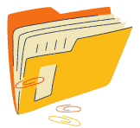
4.2.2 Types of Git Pull
Here are various types of pull strategies catering to different project needs:
Regular Pull: It initiates a standard pull operation using the git pull command.
1
Remote
Repository
Rebase Pull: It creates a linear and cleaner commit history using the git pull --rebase command.
2
PULL
Squash Pull: It involves a git pull --squash operation to fetch and condense changes into a single commit before merging.
3
PUSH
Merge Pull: It involves default pull behavior, achieved with the git pull command.
4
Local Repo
Notes:
Notes to the Facilitator:
Introduce participants to the diverse types of Git pull operations, emphasizing their significance in adapting to specific project needs. Highlight the flexibility these pull strategies offer for managing changes and collaboration preferences.
Notes to the Participants:
In Git, pulling changes is a fundamental operation for updating the local branch with modifications from a remote repository. Various types of pull strategies cater to different project needs. Let's explore these types: regular pull for automatic merging, rebase pull for a cleaner history, squash pull for condensed commits, and merge pull as the default method. Each type offers distinct advantages, providing developers with flexibility in aligning with project requirements and collaboration preferences.
Regular Pull: Initiates a standard pull operation using the git pull command, which fetches changes from the remote repository and automatically merges them into the current local branch.
Rebase Pull:Utilizes the git pull --rebase command to incorporate changes from the remote repository by first rewinding local changes, applying remote changes, and then reapplying local changes. This creates a linear and cleaner commit history.
Squash Pull:Involves a git pull --squash operation that fetches changes and condenses them into a single commit before merging. This is useful for maintaining a more streamlined commit history.
Merge Pull:The default pull behavior, achieved with the git pull command, fetches changes and merges them into the local branch using a merge commit. This method preserves the individual commit history.
Understanding these pull types provides developers with flexibility in choosing the most suitable approach based on project requirements and collaboration preferences.

Slide 24
4.2.2 Benefits and Considerations of Git Pull
Following are the benefits and considerations of Git Pull:
Benefits
Considerations
Efficiency
Automatic Merging
Convenience
Potential Conflicts
Commit History Impact
Rebase and Squash Options
Notes:
Notes to the Facilitator:
Guide participants through the benefits and considerations of Git pull, emphasizing its efficiency and automatic merging capabilities, while also addressing potential conflicts, commit history impact, and alternative options like rebase and squash.
Notes to the Participants:
Git pull is a crucial operation for maintaining an updated local branch with changes from a remote repository. Let's explore the benefits and considerations associated with this process, highlighting its efficiency, automatic merging, and convenience.
Benefits of Git Pull:
Efficiency: Git pull streamlines the process of updating the local branch with the latest changes from the remote repository, ensuring efficiency in synchronization.
Automatic Merging: Pulling automatically merges fetched changes into the current local branch, simplifying the integration process for developers.
Convenience: The pull operation combines fetching and merging in a single command, providing a convenient way to stay up-to-date with the latest developments.
Considerations:
Potential Conflicts: Automatic merging during pull may lead to conflicts. Developers should be mindful of potential conflicts and resolve them appropriately.
Commit History Impact: Pulling changes, especially with the default merge pull, can impact the commit history by introducing merge commits. This should be considered for maintaining a clean history.
Rebase and Squash Options: Consider using rebase or squash options during pull to address commit history concerns and maintain a more linear or condensed history.
Understanding the benefits and considerations of Git pull enables developers to make informed decisions when managing changes and collaborating on a project.

Slide 25

4.2.2 Use Cases for Git Pull
Use Case 1: Incorporating Remote Changes
Here are two common use cases of Git Pull along with corresponding code snippets:
This command pulls the latest changes from the remote repository's main branch and automatically merges them into the local main branch, ensuring that your local copy is up-to-date with the remote.
Notes:
Notes to the Facilitator:
Emphasize the importance of regularly fetching and pulling changes to maintain an up-to-date and collaborative development environment
Notes to the Participants:
Use Case 1: Incorporating Remote Changes
Code:
git pull origin main
This command pulls the latest changes from the remote repository's main branch and automatically merges them into the local main branch, ensuring that your local copy is up-to-date with the remote.

Slide 26

4.2.2 Use Cases for Git Pull Contd..
Use Case 2: Updating a Feature Branch
This command pulls changes from the remote repository's feature-branch and merges them into the local feature-branch. It's useful for keeping feature branches synchronized with the latest developments in the collaborative workflow.
Notes:
Notes to the Facilitator:
Emphasize the importance of regularly fetching and pulling changes to maintain an up-to-date and collaborative development environment
Notes to the Participants:
Use Case 2: Updating a Feature Branch
Code:
git pull origin feature-branch
This command pulls changes from the remote repository's feature-branch and merges them into the local feature-branch. It's useful for keeping feature branches synchronized with the latest developments in the collaborative workflow.

Slide 27
4.2.3 Pushing Changes in Git
Pushing in Git refers to the process of sending local commits to a remote repository, updating the remote branch with the latest changes.
Execute git push origin master to push local commits to the "master" branch of the remote repository named "origin."
1
Practical Steps
Git updates the remote branch with the latest changes, making them accessible to other developers.
2
Notes:
Notes to the Facilitator:
Introduce participants to the essential process of pushing changes in Git, highlighting its significance in updating remote repositories with local commits for effective collaboration.
Notes to the Participants:
Pushing in Git refers to the process of sending local commits to a remote repository, updating the remote branch with the latest changes. This operation ensures that changes made locally are shared with the entire development team, facilitating collaboration.
Practical Steps:
Execute git push origin master to push local commits to the "master" branch of the remote repository named "origin."
Git updates the remote branch with the latest changes, making them accessible to other developers.
Pushing changes is a critical step in the Git workflow, enabling seamless collaboration by sharing local contributions with the wider development community.

Slide 28
4.2.3 Types of Git Push
Here are various types of push strategies catering to different project needs:
Regular Push: Updates the remote repository with local commits using git push.
1
Remote
Repository
Force Push: Overwrites the remote branch forcefully with git push --force, with caution.
2
PULL
Pushing Specific Branch: Updates a specific remote branch, e.g., git push origin feature-branch.
1
PUSH
Push Tags: Shares tags with the remote repository using git push origin tag-name.
2
Local Repo
Notes:
Notes to the Facilitator:
Navigate participants through the various types of git push operations, emphasizing their distinct applications in version control workflows.
Notes to the Participants:
In Git, pushing changes is a dynamic process that offers different strategies to share local commits with remote repositories. Let's explore the types of git push operations, ranging from regular pushes for routine updates to force pushes for history rewriting, pushing specific branches, and sharing tags. Understanding these options empowers developers to choose the most appropriate push strategy based on project needs and collaboration scenarios.
Types of Git Push:
Regular Push: Executed using the git push command, a regular push sends all local commits to the corresponding remote branch, updating the remote repository with the latest changes.
Force Push: Utilizes the git push --force command to overwrite the remote branch with local commits forcefully. This can be useful in scenarios where history needs to be rewritten, but caution is advised due to its potential impact on collaborators.
Pushing Specific Branch: Involves specifying the branch during push, such as git push origin feature-branch, to update a specific remote branch with the local commits from the corresponding feature branch.
Push Tags: Pushing tags is accomplished with the git push origin tag-name command, allowing the sharing of annotated tags or lightweight tags with the remote repository.
Understanding these types of git push operations provides developers with flexibility in sharing their contributions and managing the version history based on project requirements and collaboration preferences.

Slide 29
4.2.3 Benefits and Considerations of Git Push
Following are the benefits and considerations of Git Push:
Benefits
Considerations
Collaborative Development
Version Control
Synchronization
Caution with Force Push
Impact on Collaborators
Conflict Resolution
Notes:
Notes to the Facilitator:
Guide participants through the benefits and considerations of Git push, emphasizing its role in collaborative development and version control
Notes to the Participants:
Git push is a fundamental operation in version control, allowing developers to share local commits with remote repositories. Let's delve into the benefits and considerations associated with git push, exploring its role in collaborative development and code sharing.
Benefits of Git Push:
Collaborative Development:Git push facilitates seamless collaboration by enabling developers to share their local commits with the entire team, ensuring everyone has access to the latest changes.
Version Control:Pushing changes contributes to maintaining version control integrity, as it updates the remote repository with the latest commits, preserving a comprehensive and accurate project history.
Synchronization:Push operations synchronize local and remote branches, keeping the entire development team on the same page and preventing divergence in the codebase.
Considerations:
Caution with Force Push:While force push allows overwriting the remote branch, it should be used cautiously to avoid unintended consequences and potential conflicts with collaborators' work.
Impact on Collaborators: Developers should be mindful of the impact on collaborators when pushing changes, ensuring effective communication and awareness of ongoing development activities.
Conflict Resolution: Pushing changes may result in conflicts with remote commits. Consideration should be given to resolving conflicts promptly to maintain a smooth development process.
Understanding the benefits and considerations of git push empowers developers to utilize this operation strategically, fostering effective collaboration and maintaining a robust version control system.

Slide 30
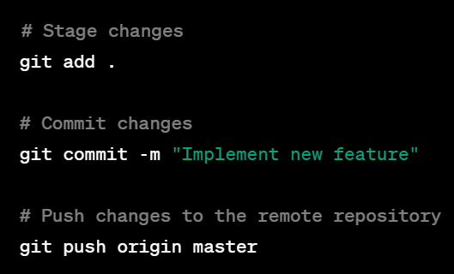
4.2.3 Use Cases for Git Push Contd..
Here are two use cases for Git Push with accompanying code examples:
Use Case 1: Pushing Local Changes to the Remote Repository
Scenario: You've made local commits and want to push them to the remote repository to share your changes with the team.
Notes:
Notes to the Facilitator:
Emphasize the importance of Git Push in collaborative workflows, allowing participants to confidently share their local changes with remote repositories and introduce new branches for effective teamwork
Notes to the Participants:
Use Case 1: Pushing Local Changes to the Remote Repository
Scenario:
You've made local commits and want to push them to the remote repository to share your changes with the team.
Code Example:
# Stage changes
git add .
# Commit changes
git commit -m "Implement new feature"
# Push changes to the remote repository
git push origin master

Slide 31
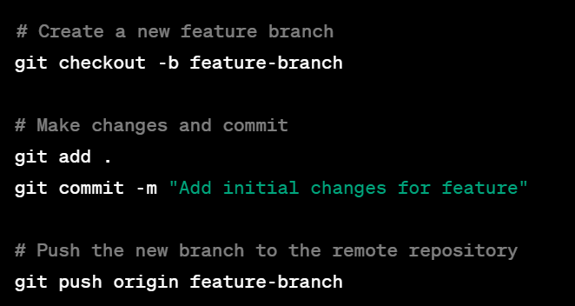
4.2.3 Use Cases for Git Push
Use Case 2: Pushing a New Branch to the Remote Repository
Scenario: You've created a new feature branch locally and want to push it to the remote repository for collaboration.
Notes:
Notes to the Facilitator:
Emphasize the importance of Git Push in collaborative workflows, allowing participants to confidently share their local changes with remote repositories and introduce new branches for effective teamwork
Notes to the Participants:
You've created a new feature branch locally and want to push it to the remote repository for collaboration.
Code Example:
# Create a new feature branch
git checkout -b feature-branch
# Make changes and commit
git add .
git commit -m "Add initial changes for feature"
# Push the new branch to the remote repository
git push origin feature-branch

Slide 32
What did you grasp?
What is the primary purpose of Git push?
  Retrieving changes from a remote repository.
  Merging local changes into the current working branch.
  Sharing local commits with a remote repository.
  Creating a new branch.
Notes:
Notes to the Facilitator:
Ask the participants to attempt the question on the screen.
Answer: C
Notes to the Participants:
Attempt the question on the screen. You will get one attempt.

Slide 33
What did you grasp?
Which type of push operation should be used cautiously due to its potential impact on the remote branch and collaborators' work?
  Regular Push
  Force Push
  Pushing Specific Branch
  Push Tags
Notes:
Notes to the Facilitator:
Ask the participants to attempt the question on the screen.
Answer: B
Notes to the Participants:
Attempt the question on the screen. You will get one attempt.

Slide 34
What did you grasp?
What does "git push --force" allow developers to do?
  Share local commits with a remote repository.
  Merge changes forcefully.
  Push changes to a specific branch.
  Push annotated tags.
Notes:
Notes to the Facilitator:
Ask the participants to attempt the question on the screen.
Answer: B
Notes to the Participants:
Attempt the question on the screen. You will get one attempt.

Slide 35
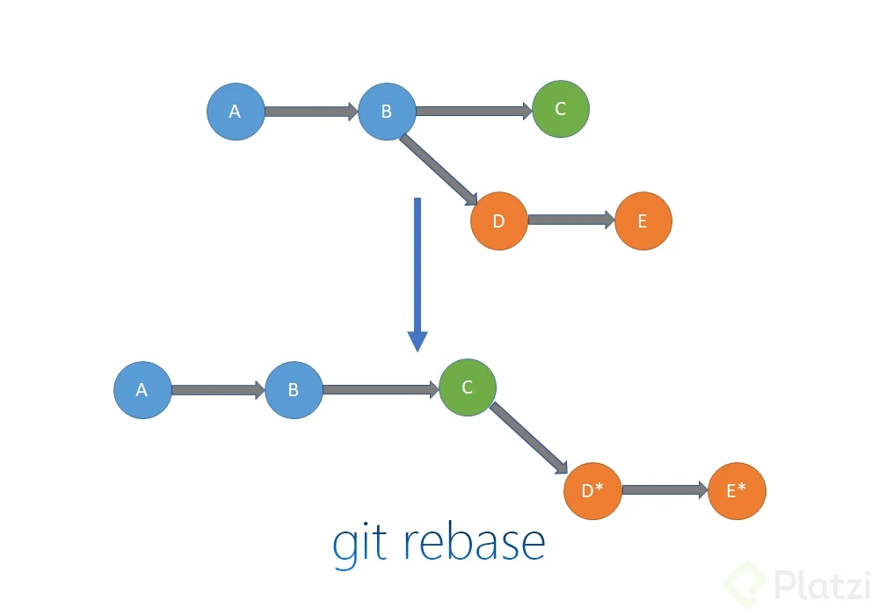
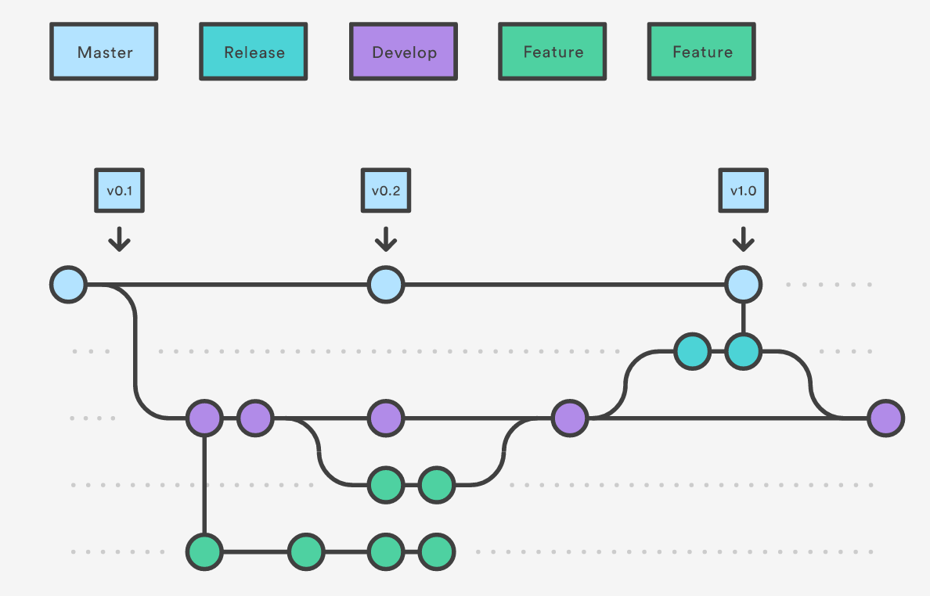
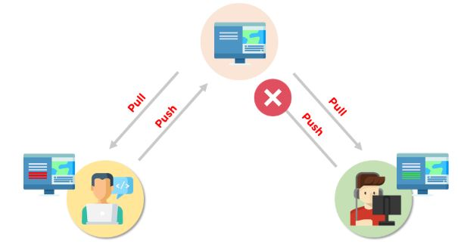
4.3.0 Advanced techniques for working with Branches on Remote Repositories
Key advanced techniques for working with branches in remote repositories include:
  Rebasing
  Squashing Commits
  Conflict Resolution Strategies
Notes:
Notes to the Facilitator:
Guide participants through an in-depth exploration of advanced Git techniques, emphasizing the nuances of rebasing, squashing commits, conflict resolution strategies.
Notes to the Participants:
As developers progress in their Git journey, mastering advanced techniques for working with branches on remote repositories becomes essential. This module delves into sophisticated strategies, including rebasing, squashing commits, and resolving conflicts when working collaboratively. Let's gain insights into optimizing branch workflows and ensuring a seamless and efficient approach to version control in a team environment.
Key Advanced Techniques:
Rebasing: Understand the power of rebasing to create a linear, clean commit history. Learn when and how to rebase local branches onto remote branches, enhancing code clarity and simplifying collaboration.
Squashing Commits: Explore the art of squashing commits to condense multiple changes into a single, meaningful commit. Discover how this technique contributes to a more readable and concise project history.
Conflict Resolution Strategies: Delve into advanced conflict resolution strategies, especially when dealing with conflicts arising from rebasing or merging. Master the use of merge tools and manual conflict resolution to navigate complex collaborative scenarios seamlessly.
Through this exploration of advanced techniques, participants will elevate their Git proficiency, enabling them to navigate complex collaborative scenarios and contribute effectively to team projects.

Slide 36
4.3.1 Rebasing in Git
Rebasing is an advanced Git technique that involves altering the commit history by moving or combining commits.
Key Concepts:
  Linearizing Commit History
  Executing a Rebase
  Resolving Conflicts
  Interactive Rebasing
A
B
C
D
A
B
C
D*
E*
git rebase
Notes:
Notes to the Facilitator:
Guide participants through the intricacies of rebasing, emphasizing its role in creating a linear commit history and the importance of conflict resolution during the process.
Notes to the Participants:
Rebasing is an advanced Git technique that involves altering the commit history by moving or combining commits. Unlike merging, which creates a new commit to reconcile changes, rebasing integrates changes by placing the entire sequence of local commits onto a different base commit.
Key Concepts:
Linearizing Commit History: Rebasing aims to create a linear commit history by placing local commits on top of another branch's commit, often the updated remote branch. This results in a clean and straightforward chronological order of changes.
Executing a Rebase: To rebase, use the command git rebase <base-branch> while on the branch containing the commits you want to reapply. This shifts the branch's base to the specified commit.
Resolving Conflicts:Rebasing may lead to conflicts if changes in the local branch cannot be seamlessly applied on top of the new base. Resolve conflicts manually or by using merge tools during the rebase process.
Interactive Rebasing:git rebase -i allows for interactive rebasing, offering granular control over each commit. Developers can squash, edit, reword, or drop commits during this interactive process.
Understanding the intricacies of rebasing empowers developers to create a more coherent and readable project history, promoting efficient collaboration and code maintenance.

Slide 37
4.3.2 Squash Commits
Squashing commits is a technique in Git that involves combining multiple commits into a single, coherent commit.
Key Concepts:
  Linearizing Commit History
  Executing a Rebase
  Resolving Conflicts
  Interactive Rebasing
Notes:
Notes to the Facilitator:
Guide participants through the process of squashing commits, emphasizing the benefits of improved code readability and reduced noise in the commit history,
Notes to the Participants:
Squashing commits is a technique in Git that involves combining multiple commits into a single, coherent commit. This process is particularly useful for condensing and simplifying the commit history, making it more readable and focused.
Key Concepts:
Creating Meaningful Commits:Squashing commits helps in creating more meaningful and comprehensive commit messages, as multiple related changes can be encapsulated in a single commit.
Executing a Squash:To squash commits, use the interactive rebase command with the option -i and specify the number of commits to squash. During the interactive rebase, mark commits as "squash" or "s" to combine them into the previous commit.
Editing Commit Messages:While squashing, developers have the opportunity to edit commit messages for clarity and conciseness, ensuring the final commit communicates the intended changes effectively.
Practical Steps:
Initiate an interactive rebase with git rebase -i HEAD~n, where "n" is the number of commits you want to include in the interactive rebase.
Mark commits as "squash" or "s" to combine them. Edit commit messages as needed.
Complete the rebase process to create a squashed commit.
Understanding how to squash commits empowers developers to maintain a clean and focused commit history, fostering better collaboration and code comprehension.

Slide 38
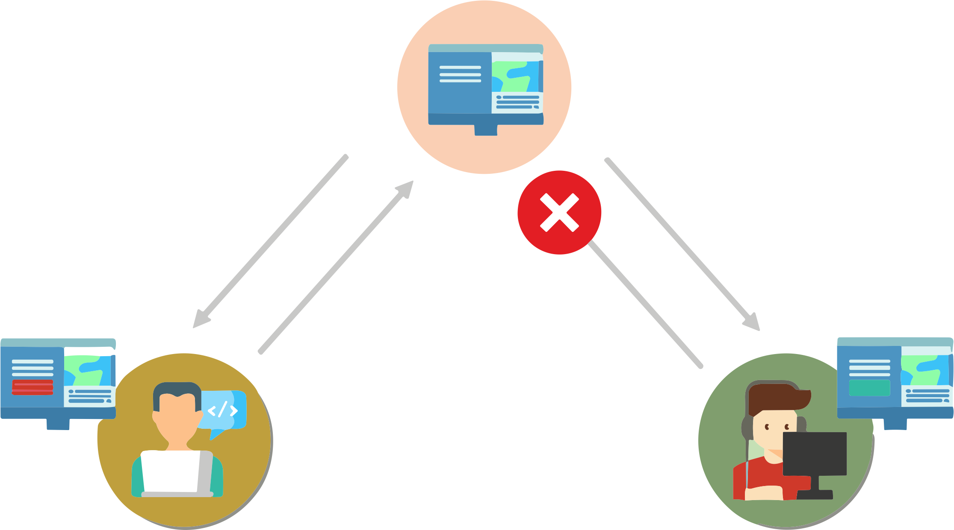
4.3.3 Conflict Resolution Strategies
Conflicts may arise in Git when changes in different branches cannot be seamlessly merged. Here are key strategies for conflict resolution:
Key Strategies:
  Manual Conflict Resolution: git add
  Merge Tool: git mergetool
  Aborting the Merge:git merge --abort
  Interactive Rebase: git rebase -i
  Communication and Collaboration
Best Practices:
  Regular Updates
  Clear Commit Messages
Pull
Pull
Push
Push
Notes:
Notes to the Facilitator:
Navigate the intricacies of Git conflict resolution with strategies like manual editing, merge tools, and collaborative best practices, ensuring a seamless and error-free codebase.
Notes to the Participants:
Conflicts may arise in Git when changes in different branches cannot be seamlessly merged. Effectively resolving these conflicts is crucial for maintaining a cohesive and error-free codebase. Here are key strategies for conflict resolution:
Manual Conflict Resolution: Developers can manually edit the conflicting sections in the affected files to reconcile differences. After resolving conflicts, they need to mark the files as resolved using git add and continue with the commit process.
Merge Tool: Git provides merge tools that assist in visualizing and resolving conflicts. Developers can configure their preferred merge tool using git mergetool and use it to navigate and resolve conflicts.
Aborting the Merge: If conflicts become too complex or are challenging to resolve, developers have the option to abort the merge using git merge --abort and then manually address the conflicting changes.
Interactive Rebase: In some cases, conflicts can be resolved during an interactive rebase. Developers can use the interactive rebase command (git rebase -i) to address conflicts and reapply commits.
Communication and Collaboration: Effective communication among team members is essential. Developers should coordinate and communicate changes to minimize conflicting modifications. Collaboration can prevent conflicts or address them promptly.
Best Practices:
Regular Updates: Keep branches up-to-date with the latest changes from the remote repository to reduce the likelihood of conflicts.
Clear Commit Messages: Write clear and descriptive commit messages to help collaborators understand the purpose of each change, making conflict resolution more straightforward.

Slide 39
What did you grasp?
What is the primary purpose of rebasing in Git?
  Creating a new branch
  Merging two branches
  Altering the commit history
  Resolving merge conflicts
Notes:
Notes to the Facilitator:
Ask the participants to attempt the question on the screen.
Answer: C
Notes to the Participants:
Attempt the question on the screen. You will get one attempt.

Slide 40
What did you grasp?
What is a common strategy for resolving Git conflicts manually?
  Force push
  Merge without conflict resolution
  Use of a merge tool
  Ignoring conflicts
Notes:
Notes to the Facilitator:
Ask the participants to attempt the question on the screen.
Answer: C
Notes to the Participants:
Attempt the question on the screen. You will get one attempt.

Slide 41
What did you grasp?
Squashing commits in Git involves:
  Combining multiple commits into a single commit
  Creating duplicate commits
  Automatically resolving conflicts
  Deleting all commits in a branch
Notes:
Notes to the Facilitator:
Ask the participants to attempt the question on the screen.
Answer: A
Notes to the Participants:
Attempt the question on the screen. You will get one attempt.

Slide 42
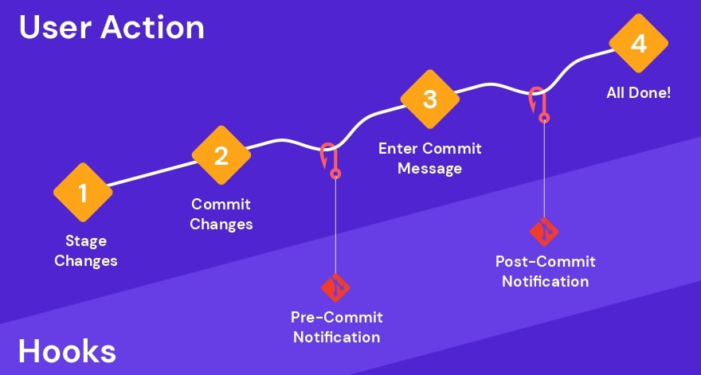
4.4.0 Git Hooks
Git hooks are scripts that can be triggered at certain points in the Git workflow, allowing developers to customize and automate actions.
Key Concepts:
  Types of Git Hooks
  Customization and Automation
  Location and Naming Convention
  Preventing Commits with Pre-commit Hooks
  Server-Side Hooks
.
Notes:
Notes to the Facilitator:
Highlight the flexibility and power of Git hooks in automating and enforcing project-specific workflows. Encourage participants to explore and customize hooks based on their project needs for a more efficient and controlled development process.
Notes to the Participants:
Git hooks are scripts that can be triggered at certain points in the Git workflow, allowing developers to customize and automate actions. These scripts are executed in response to specific Git events, such as pre-commit, post-commit, pre-push, and more. Git hooks provide a way to enforce project-specific policies, perform checks, or integrate with external tools seamlessly.
Key Concepts:
Types of Git Hooks: Git supports various hooks, including pre-commit, post-commit, pre-push, pre-receive, and post-receive. Each type corresponds to a specific phase in the Git workflow.
Customization and Automation: Hooks enable developers to customize and automate tasks according to project requirements. This can include code linting, formatting checks, or triggering automated tests.
Location and Naming Convention:Git hooks reside in the .git/hooks directory of a Git repository. Each hook script follows a specific naming convention (e.g., pre-commit.sample). Renaming the sample scripts and removing the .sample extension activates the hooks.
Preventing Commits with Pre-commit Hooks: A common use of pre-commit hooks is to perform checks before allowing a commit. This can include running static code analysis, ensuring code formatting standards, or validating commit messages.
Server-Side Hooks: Hooks such as pre-receive and post-receive are executed on the server side during push operations. These hooks allow administrators to enforce policies, check for large files, or perform other actions before accepting changes.
.

Slide 43
4.4.1 Types of Hooks
Here are different types of Git hooks:
Pre-commit Hook
Post-receive Hook
1
4
Post-commit Hook
Pre-push Hook
2
5
Pre-receive Hook
Update Hook
3
6
Notes:
Notes to the Facilitator:
Guide participants through the diverse functionalities of Git hooks, ranging from pre-commit checks to post-receive actions, providing them with tools to customize and enhance their Git workflows.
Notes to the Participants:
Git hooks are scripts that Git executes before or after certain events. They are used to customize Git's behavior.
Here are some common types of Git hooks:
Pre-commit Hook:
The pre-commit hook in Git is a script executed just before the commit is finalized. Its primary purpose is to allow developers to perform checks and validations on changes before committing them to the repository. This hook is instrumental for running linters, tests, or formatting checks, ensuring that the committed changes adhere to established coding standards.
Post-commit Hook:
Conversely, the post-commit hook is executed after the commit is finalized. This type of hook is utilized for tasks that should occur immediately after a successful commit. Examples of post-commit actions include triggering notifications to team members, updating project documentation, or integrating changes with external tools to maintain a synchronized development environment.
Pre-receive Hook:
Moving to server-side hooks, the pre-receive hook is executed on the server before updates are accepted into the repository. This hook plays a critical role in enforcing project-specific policies and has the ability to reject certain changes. It is commonly used for access control measures and to ensure code quality by running checks before changes are incorporated into the shared repository.
Post-receive Hook:
The post-receive hook, also server-side, is executed after updates are accepted into the repository. It serves as a powerful tool for various tasks, such as triggering deployment processes or updating issue-tracking systems. This hook provides opportunities for actions that need to occur once changes have been successfully received and integrated into the central repository.
Pre-push Hook:
The pre-push hook is executed before remote references are updated during a push operation. This hook allows developers to validate changes before pushing them to a remote repository. It is particularly helpful for running additional tests or checks, ensuring that only high-quality changes are pushed to the shared repository.
Update Hook:
Lastly, the update hook is executed on the server when a branch or tag is being modified. Similar to the pre-receive hook, it is specific to individual branches or tags and is used for enforcing branch-specific policies. This hook ensures that modifications align with the defined rules and policies set for the respective branches or tags in the repository.

Slide 44

4.4.2 Pre-commit Hooks
A pre-commit hook in Git is a script that runs automatically before a commit is finalized.
Key Characteristics:
  Linting and Formatting
  Testing
  Dependency Checks
  Code Quality Checks
  Documentation Checks
Notes:
Notes to the Facilitator:
Highlight the importance of pre-commit hooks in maintaining code quality and preventing issues from being committed. Encourage participants to configure pre-commit hooks based on their project's requirements, integrating checks and validations that align with their development standards.
Notes to the Participants:
A pre-commit hook in Git is a script that runs automatically before a commit is finalized. It provides an opportunity to perform checks, validations, or modifications on the changes about to be committed. Pre-commit hooks help ensure that committed changes meet certain criteria, enhancing code quality and consistency.
Key Characteristics:
Linting and Formatting: Pre-commit hooks are commonly used to run linters and code formatters on the changes. This ensures that the committed code adheres to style guidelines and best practices.
Testing: Automated tests can be triggered in the pre-commit hook to catch potential issues before they are committed. This helps prevent the introduction of faulty code into the repository.
Dependency Checks: Verify dependencies and package versions to ensure that the project's dependencies are consistent and up-to-date before making a commit.
Code Quality Checks: Perform static code analysis or other code quality checks to catch issues related to maintainability, readability, or potential bugs.
Documentation Checks: Ensure that documentation is up-to-date and follows specified standards. This may include generating or updating documentation files.

Slide 45
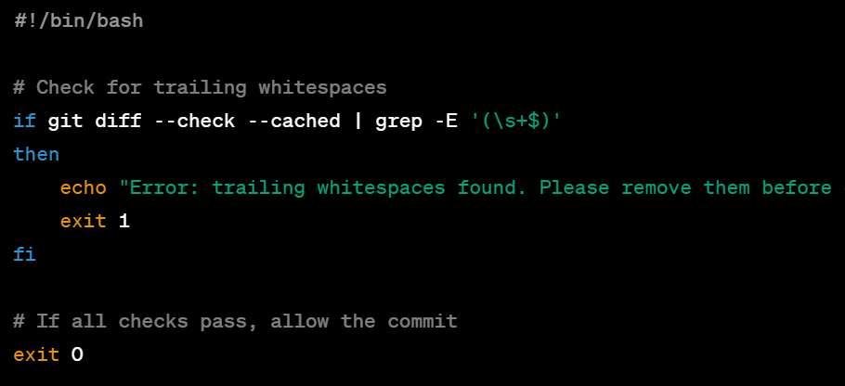
4.4.2 Pre-commit Hooks Example
Here's a simple example of a pre-commit hook in Bash that checks for trailing whitespaces:
  Create a file named .git/hooks/pre-commit in your Git repository.
  Make the file executable: chmod +x .git/hooks/pre-commit
  Edit the .git/hooks/pre-commit file with the following content:
Notes:
Notes to the Facilitator:
Facilitate participants in implementing a basic pre-commit hook using a Bash script to detect and prevent trailing whitespaces in their Git changes before committing.
Notes to the Participants:
Here's a simpler example of a pre-commit hook in Bash that checks for trailing whitespaces:
Create a file named .git/hooks/pre-commit in your Git repository.
Make the file executable: chmod +x .git/hooks/pre-commit
Edit the .git/hooks/pre-commit file with the following content:
#!/bin/bash
# Check for trailing whitespaces
if git diff --check --cached | grep -E '(\s+$)'
then
echo "Error: trailing whitespaces found. Please remove them before committing."
exit 1
fi
# If all checks pass, allow the commit
exit 0
This simple script checks for trailing whitespaces in the changes to be committed. If any trailing whitespaces are found, the script exits with an error message, preventing the commit. Otherwise, it allows the commit to proceed.

Slide 46
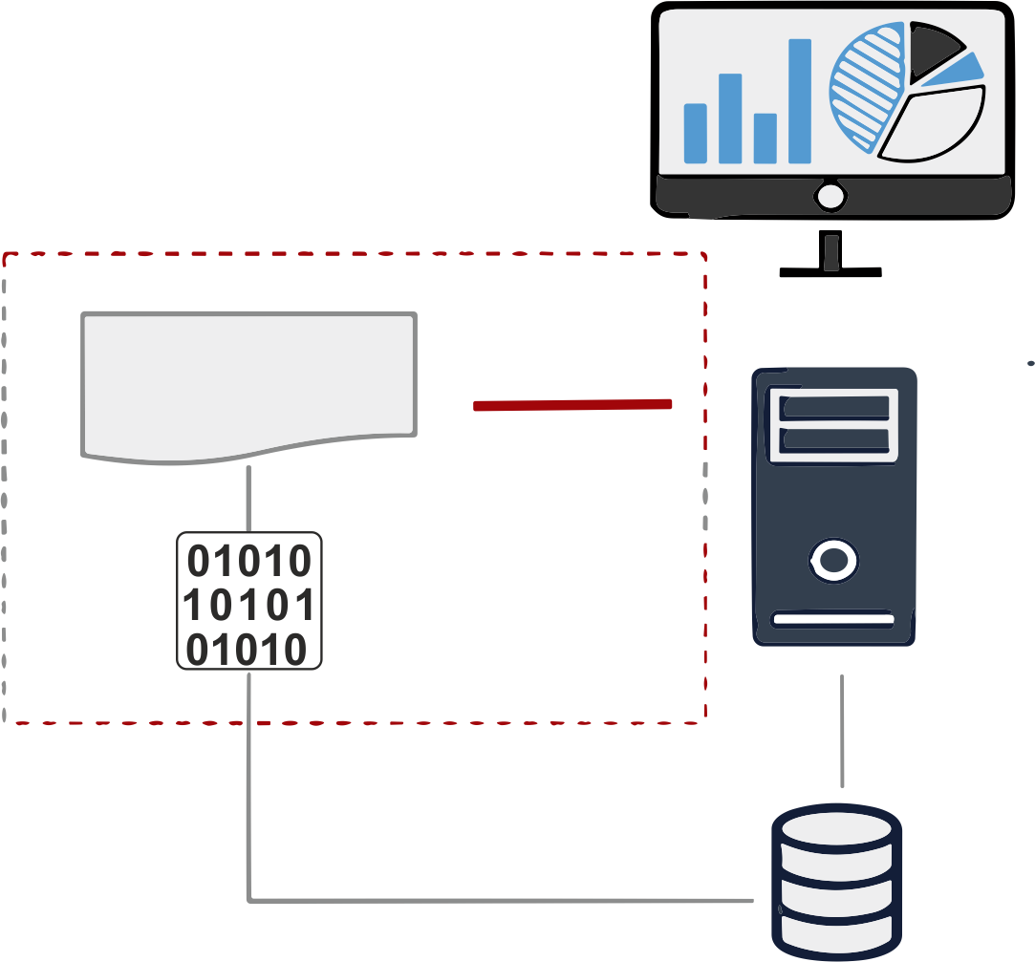
4.4.3 Post -commit Hooks
A post-commit hook in Git is a script that runs automatically after a commit is finalized.
Key Characteristics:
  Notification and Logging
  Integration with External Tools
  Documentation Updates
  Deployment Triggers
  Custom Workflows
Business Central
post-commit (hook)
every action
git repos (.niogit)
Notes:
Notes to the Facilitator:
Guide participants in understanding post-commit hooks, emphasizing their automatic execution after a commit, and key characteristics like notification/logging, integration with external tools, documentation updates, deployment triggers, and customizable workflows to meet project-specific requirements.
Notes to the Participants:
Post-commit Hooks in Git:
A post-commit hook in Git is a script that runs automatically after a commit is finalized. It provides an opportunity to perform tasks or actions that should occur immediately after a successful commit. Post-commit hooks are useful for tasks that are related to the commit but don't impact the actual content of the commit.
Key Characteristics:
Notification and Logging:Send notifications or log information about the commit. This can include notifying team members, updating a log file, or triggering other communication mechanisms.
Integration with External Tools:Integrate with external tools or services. For example, update an issue tracking system, trigger a build pipeline, or notify a continuous integration system about the new commit.
Documentation Updates:Automatically update project documentation or release notes based on the committed changes. This ensures that documentation stays synchronized with the codebase.
Deployment Triggers:Initiate deployment processes or actions. Post-commit hooks can be used to trigger deployments to development or staging environments to validate the latest changes.
Custom Workflows:Implement custom workflows or actions that are specific to the project's requirements. This can include running scripts, generating reports, or performing any task relevant to the commit.

Slide 47
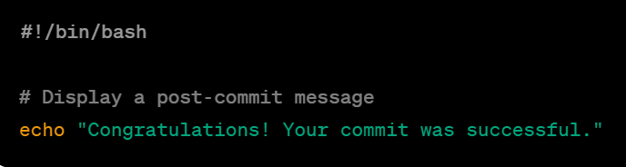
4.4.3 Post - commit Example
Here's a simple example of a post-commit hook:
  Create a file named .git/hooks/post-commit in your Git repository.
  Make the file executable: chmod +x .git/hooks/post-commit
  Edit the .git/hooks/post-commit file with the following content:
Notes:
Notes to the Facilitator:
Introduce participants to the concept of post-commit hooks with a straightforward example that provides a post-commit message.
Notes to the Participants:
Here's a simple example of a post-commit hook in Bash that echoes a message after each commit:
Create a file named .git/hooks/post-commit in your Git repository.
Make the file executable:
chmod +x .git/hooks/post-commit
Edit the .git/hooks/post-commit file with the following content:
#!/bin/bash
# Display a post-commit message
echo "Congratulations! Your commit was successful."
This basic script will echo a congratulatory message to the terminal after each commit. You can customize the script to perform additional actions or display different messages based on your project's requirements.

Slide 48
4.4.4 Pre-receive Hook
A pre-receive hook in Git is a server-side hook that is invoked before Git processes any incoming push.
Here's a simple example of a post-commit hook:
  Create a file named pre-receive in the hooks directory of your bare Git repository (usually located at repository.git/hooks/pre-receive).
  Make the file executable: chmod +x path/to/repository.git/hooks/pre-receive
Notes:
Notes to the Facilitator:
Guide participants through the implementation of pre-receive hooks in Git, emphasizing their server-side role in enforcing policies or conditions before accepting incoming pushes, showcasing a practical example that ensures commit messages contain a specific keyword for enhanced commit validation and repository governance.
Notes to the Participants:
A pre-receive hook in Git is a server-side hook that is invoked before Git processes any incoming push. It allows administrators to enforce certain policies or conditions before accepting changes into the repository. The pre-receive hook is typically used to validate commits, check for coding standards, or ensure that only authorized changes are accepted.
Here is a basic example of a pre-receive hook in Bash that enforces a rule that commit messages must contain a specific keyword:
Create a file named pre-receive in the hooks directory of your bare Git repository (usually located at repository.git/hooks/pre-receive).
Make the file executable: chmod +x path/to/repository.git/hooks/pre-receive
Edit the pre-receive file with the following content:
#!/bin/bash
zero_commit="0000000000000000000000000000000000000000"
while read oldrev newrev refname; do
# Check if it's a new branch being created
if [ "$oldrev" = "$zero_commit" ]; then
# Allow creation of new branches
continue
fi
# Extract commit messages for each new commit
commits=$(git log --format=%B $oldrev..$newrev)
# Check if the commit message contains the keyword "RELEASE"
if [[ "$commits" != *"RELEASE"* ]]; then
echo "Error: Commits must contain the keyword 'RELEASE'."
exit 1
fi
done
exit 0
This example checks that each commit in the push contains the keyword "RELEASE" in its message. If not, the push is rejected with an error message.

Slide 49
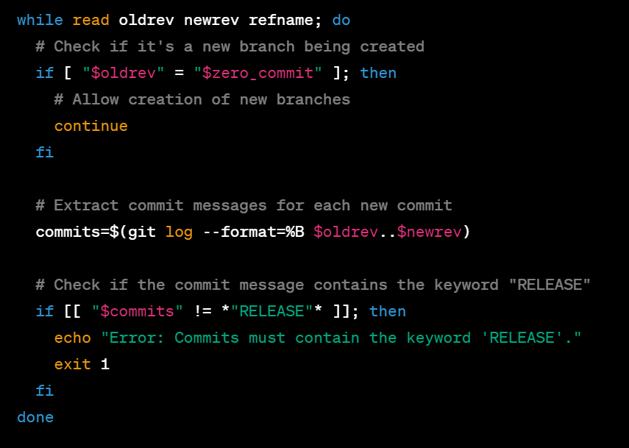
4.4.4 Pre-receive Hook Contd..
Here's a further step of example of a post-commit hook:
  Edit the pre-receive file with the following content:
Notes:
Notes to the Facilitator:
Guide participants through the implementation of pre-receive hooks in Git, emphasizing their server-side role in enforcing policies or conditions before accepting incoming pushes, showcasing a practical example that ensures commit messages contain a specific keyword for enhanced commit validation and repository governance.
Notes to the Participants:
A pre-receive hook in Git is a server-side hook that is invoked before Git processes any incoming push. It allows administrators to enforce certain policies or conditions before accepting changes into the repository. The pre-receive hook is typically used to validate commits, check for coding standards, or ensure that only authorized changes are accepted.
Here is a basic example of a pre-receive hook in Bash that enforces a rule that commit messages must contain a specific keyword:
Create a file named pre-receive in the hooks directory of your bare Git repository (usually located at repository.git/hooks/pre-receive).
Make the file executable: chmod +x path/to/repository.git/hooks/pre-receive
Edit the pre-receive file with the following content:
#!/bin/bash
zero_commit="0000000000000000000000000000000000000000"
while read oldrev newrev refname; do
# Check if it's a new branch being created
if [ "$oldrev" = "$zero_commit" ]; then
# Allow creation of new branches
continue
fi
# Extract commit messages for each new commit
commits=$(git log --format=%B $oldrev..$newrev)
# Check if the commit message contains the keyword "RELEASE"
if [[ "$commits" != *"RELEASE"* ]]; then
echo "Error: Commits must contain the keyword 'RELEASE'."
exit 1
fi
done
exit 0
This example checks that each commit in the push contains the keyword "RELEASE" in its message. If not, the push is rejected with an error message.

Slide 50
4.4.5 Deployment Triggers
These triggers are commonly used to streamline the deployment of applications or updates to production servers. Here's an overview of the steps to set up a deployment trigger using a post-receive hook:
Create a Post-receive Hook
Navigate to the hooks directory in your Git repository (e.g., repository.git/hooks/).
Create a file named post-receive.
Make the file executable:
chmod +x path/to/repository.git/hooks/post-receive.
Notes:
Notes to the Facilitator:
Guide participants in implementing effective deployment triggers in Git, utilizing post-receive hooks to automate deployment processes and streamline application updates to production servers, ensuring seamless integration and efficient deployment workflows.
Notes to the Participants:
In a Git context, deployment triggers, often implemented through post-receive hooks, are mechanisms that automatically initiate deployment processes upon the successful reception of new commits. These triggers are commonly used to streamline the deployment of applications or updates to production servers.
Here's an overview of the steps to set up a deployment trigger using a post-receive hook:
Create a Post-receive Hook:
Navigate to the hooks directory in your Git repository (e.g., repository.git/hooks/).
Create a file named post-receive.
Make the file executable: chmod +x path/to/repository.git/hooks/post-receive.

Slide 51
4.4.5 Deployment Triggers Contd..
Here's an overview of the steps to set up a deployment trigger using a post-receive hook:
Define Deployment Script : deploy_script="/path/to/deployment-script.sh"
Set Up Deployment Script :
Create a separate deployment script (e.g., deployment-script.sh)
Make the deployment script executable:
chmod +x /path/to/deployment-script.sh.
Notes:
Notes to the Facilitator:
Discuss the significance of deployment triggers and post-receive hooks in automating deployment processes
Notes to the Participants:
Define Deployment Script:
Edit the post-receive file and define the deployment script or command you want to execute upon receiving new commits.
This script typically includes steps such as pulling the latest changes, building the application, restarting services, or any other actions necessary for deployment.
Example post-receive script:
#!/bin/bash
# Define deployment script
deploy_script="/path/to/deployment-script.sh"
# Execute deployment script
$deploy_script
Set Up Deployment Script:
Create a separate deployment script (e.g., deployment-script.sh) that contains the detailed deployment steps.
Make the deployment script executable: chmod +x /path/to/deployment-script.sh.

Slide 52
4.4.5 Deployment Triggers Contd..
Here's an overview of the further steps to set up a deployment trigger using a post-receive hook:
Configure Deployment Environment:
Set up the production server with required configurations for the deployment script.
Testing and Integration:
Validate the deployment trigger by pushing new commits, and integrate it into your CI or deployment pipeline for automation.
Notes:
Notes to the Facilitator:
Discuss the significance of deployment triggers and post-receive hooks in automating deployment processes
Notes to the Participants:
Configure Deployment Environment:
Ensure that the deployment environment (e.g., production server) is set up with the necessary configurations and permissions for the deployment script to run successfully.
Testing and Integration:
Test the deployment trigger by pushing new commits to the repository and observing the deployment process.
Integrate the deployment trigger into your continuous integration (CI) or deployment pipeline for automated deployments.

Slide 53
4.4.6 Documentation Checks
Documentation checks, often implemented using pre-commit or pre-push hooks, are mechanisms to enforce documentation standards and quality in a Git repository
Here's an example of implementing documentation checks using a pre-commit hook:
Create a Pre-commit Hook:
Navigate to the .git/hooks/ directory in your Git repository.
Create a file named pre-commit.
Make the file executable: chmod +x .git/hooks/pre-commit.
Notes:
Notes to the Facilitator:
Guide participants through the implementation of robust documentation checks in Git using pre-commit hooks, ensuring project documentation adheres to standards, remains accurate, and contributes to a high-quality codebase.
Notes to the Participants:
Documentation checks, often implemented using pre-commit or pre-push hooks, are mechanisms to enforce documentation standards and quality in a Git repository. These checks help ensure that project documentation is accurate, up-to-date, and follows established guidelines.
Here's an example of implementing documentation checks using a pre-commit hook:
Create a Pre-commit Hook:
Navigate to the .git/hooks/ directory in your Git repository.
Create a file named pre-commit.
Make the file executable: chmod +x .git/hooks/pre-commit.

Slide 54
4.4.6 Documentation Checks Contd..
Here are further steps for an example of implementing documentation checks using a pre-commit hook:
Define Documentation Checks:
Edit the pre-commit file and define the documentation checks you want to perform before allowing a commit
Testing & Integration:
Validate documentation checks by committing changes, ensuring compliance with documentation standards, and seamlessly integrate the pre-commit hook into your workflow.
Notes:
Notes to the Facilitator:
Guide participants through the implementation of robust documentation checks in Git using pre-commit hooks, ensuring project documentation adheres to standards, remains accurate, and contributes to a high-quality codebase.
Notes to the Participants:
Define Documentation Checks:
Edit the pre-commit file and define the documentation checks you want to perform before allowing a commit.
Common checks include verifying the presence of specific documentation files, ensuring they are not empty, or running linters to validate documentation syntax.
Example pre-commit script:
#!/bin/bash
# Check for the presence of documentation files
if [ ! -f README.md ]; then
echo "Error: README.md is missing. Please add project documentation."
exit 1
fi
# Check for empty documentation files
if [ -s CHANGELOG.md ]; then
echo "Error: CHANGELOG.md is empty. Please add project changelog information."
exit 1
fi
# Additional documentation checks...
# If all checks pass, allow the commit
exit 0
Testing and Integration:
Test the documentation checks by attempting to commit changes with missing or empty documentation files.
Integrate the pre-commit hook into your workflow to enforce documentation standards for all contributors.

Slide 55
What did you grasp?
What is the purpose of a pre-commit hook in Git?
  To execute tasks after a commit is made.
  To perform actions before the commit is finalized.
  To handle actions during a merge process.
  To synchronize changes between local and remote repositories.
Notes:
Notes to the Facilitator:
Ask the participants to attempt the question on the screen.
Answer: B
Notes to the Participants:
Attempt the question on the screen. You will get one attempt.

Slide 56
What did you grasp?
When does a post-commit hook in Git execute?
  Before the commit is staged.
  After the commit is successfully made.
  During the process of branch merging.
  When fetching changes from a remote repository.
Notes:
Notes to the Facilitator:
Ask the participants to attempt the question on the screen.
Answer: B
Notes to the Participants:
Attempt the question on the screen. You will get one attempt.

Slide 57
What did you grasp?
What does a pre-receive hook in Git primarily control?
  Actions before a commit is finalized.
  Actions after a commit is successfully made.
  Actions during the push to a remote repository.
  Actions during the process of rebasing.
Notes:
Notes to the Facilitator:
Ask the participants to attempt the question on the screen.
Answer: C
Notes to the Participants:
Attempt the question on the screen. You will get one attempt.

Slide 58
In a nutshell, we learnt:
Grasped essential Git commands for basic version control.
Explored cloning, tracking branches, and syncing changes with remote repositories.
Learned advanced techniques like rebasing and commit squashing.
Implemented pre and post-commit hooks for customized workflows.
Notes:
Notes to the Facilitator:
Share the module summary with the participants.
Ask the participants if they have any questions. They can ask their queries by raising their hands.
Notes to the Participants:
Congratulations on completing this module! Throughout, you've acquired foundational Git commands, delved into cloning, tracking branches, and synchronizing changes with remote repositories. Additionally, you've mastered advanced techniques like rebasing and commit squashing, along with implementing pre and post-commit hooks for tailored workflows. Well done!

Slide 59
Next Module:

